Slide 1
Final Project Presentation: NYC Property Sales
Markus Afonso

Slide 2
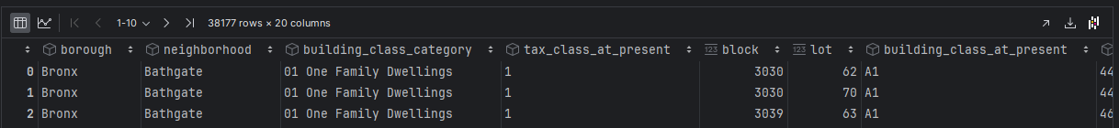
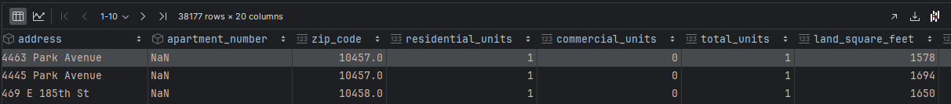
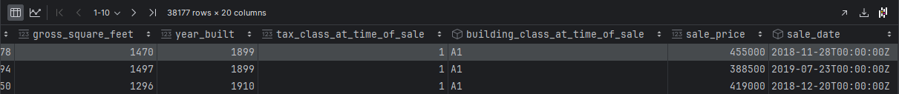
Problem Definition:
Problem Definition: What is the projected sale price of a 2000 sqft home?
Dataset:

Slide 3
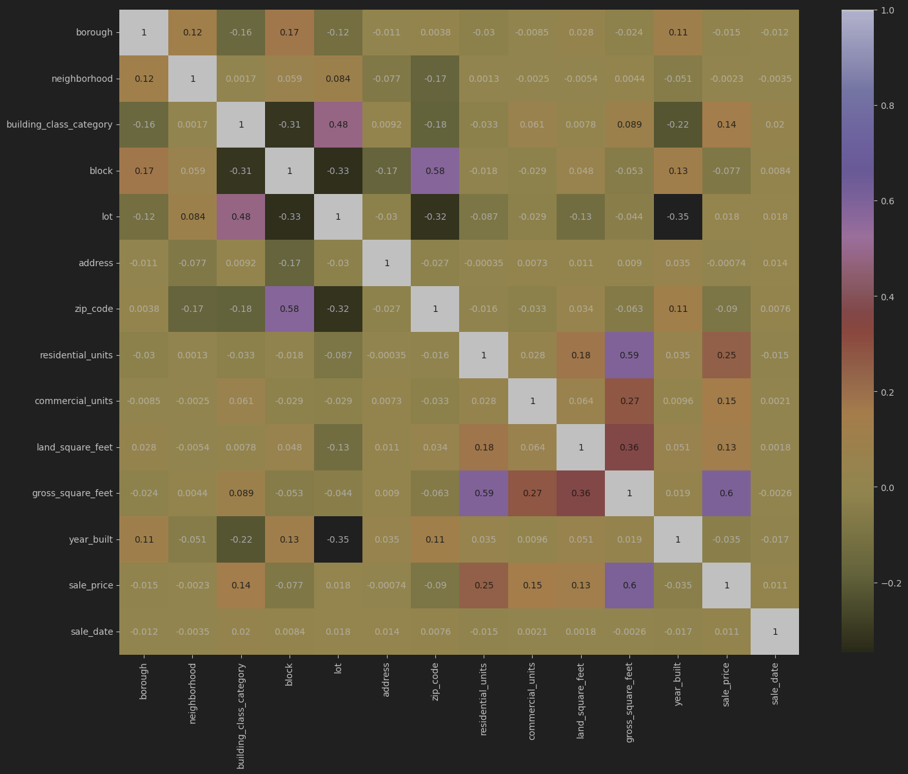
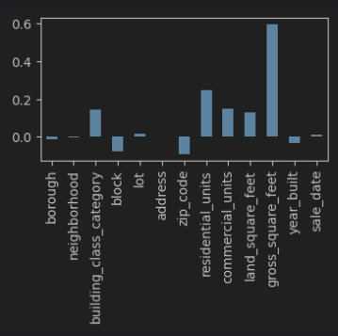
Feature Scaling:
gross_square_feet, residential_units, commercial_units, land_square_feet

Slide 4
Data Modeling - Model Selection
Decision Tree
Simple and easy to understand
Random Forest
multiple decision trees to improve accuracy and reduce overfitting
Gradient Boosting Regression (GBR)
Like random forest
Seemed cool

Slide 5
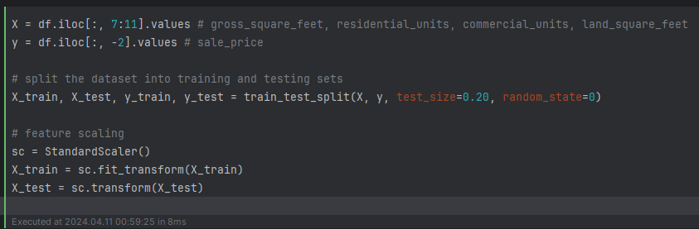
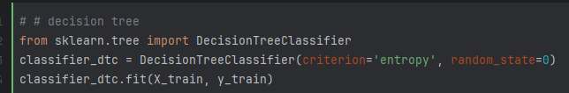
Data Modeling - Implementation

Slide 6
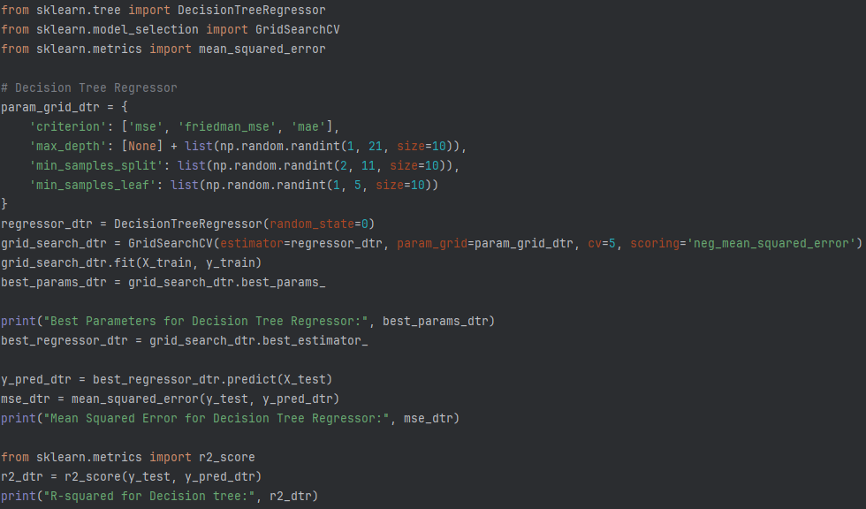
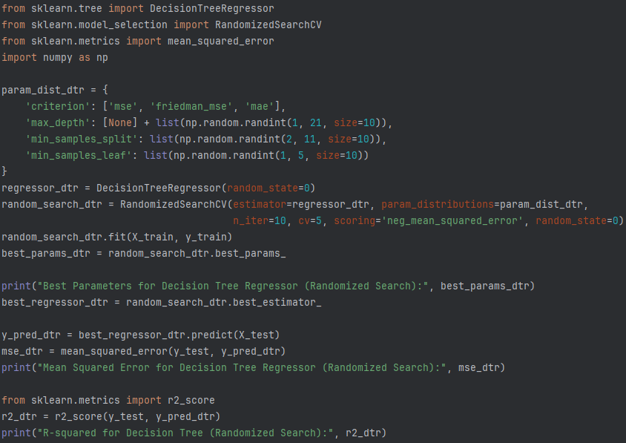


Data Modeling - Hyperparameter Tuning

Slide 7

Evaluation
28,060,265,946
15,367,446,607
10,672,820,290
Predicted price of a 2000 gross_square_feet_home

Slide 8
Conclusion:
data analytics techniques
Clean and transform data
models using statistical techniques
data visualization tools
Evaluate and interpret results
Machine Learning

Slide 9
Thank you

